Slide 1

Graph Algorithms (CS3283)
Department of Computer Science,
Capital University of Science and Technology, Islamabad
Fall Semester, 2022

Slide 2
Lecture Outlines
Course Contents and Organization
Instructor Information
Course Motivation
Aims
Literature

Slide 3
Course Contents and Organization
See outline on Portal for:
Course Contents
Evaluation Criteria

Slide 4
Course Objectives
Course learning Outcomes (CLOs):
At the end of this course, the students should be able to
CLO:1 Learn and Recognize the basics of graphs, graph algorithms.
CLO:2 How to analyze graph algorithms and estimate their cost.
CLO:3 Apply the concepts of graphs by using different programming techniques

Slide 5
Pre-Requisites
CS2143: Data Structures
Thirst for knowledge…

Slide 6
Course Information
In this course, you will learn what a graph is and its most important properties.
You’ll learn several ways to traverse graphs and how you can do useful things while traversing the graph in some order.
We will also talk about shortest paths algorithms.
Minimum spanning trees, which are used to plan road, telephone and computer networks and also find applications in clustering and approximate algorithms.

Slide 7
Course Motivations
If you have ever used a navigation service to find the optimal route and estimate time to destination, you've used algorithms on graphs.
Graphs arise in various real-world situations, as there are road networks, water and electricity supply networks, computer networks and, most recently, social networks!

Slide 8
Course Motivations
If you're looking
for the fastest time to get to work,
cheapest way to connect set of computers into a network or
efficient algorithm to automatically find communities and
opinion leaders in Facebook,
you're going to work with graphs and algorithms on graphs.

Slide 9
Aims
Graph exploration and decomposition into connected components
Shortest paths algorithms, including breadth-first search, Dijkstra’s algorithm and Bellman-Ford algorithm
Minimum spanning tree algorithms
Community Detection
Graph Coloring
Identification of important nodes in a graph

Slide 10
Aims
Important Classes of Graph Problems
Basic understanding of Graph Algorithms
How to use Graph Algorithms as a modelling tool to solve problems?
How to solve problems of computer science, biology, and engineering using Graph Algorithms?

Slide 11
Instructor Information
Mr. Omaid Ghayyur
Contact:
Office:
Block C 2nd Floor, Faculty Offices
Email:
omaid.ghayyur@cust.edu.pk
Counseling hours
TUE | 10:00 AM-11:30 AM
Mon | 09:00 AM-11:00 AM

Slide 12
Literature
Books
Recommended Book(s):
Graphs, Networks and Algorithms, 4th Edition by Dieter Jungnickel
Graph Theory & Applications, 1st Edition by Fournier. Published by Wiley-ISTE, 2011
Reference Books(s):
Graph Theory with Applications to Engineering and Computer Science by Narsingh Deo
Network Analysis Methodological Foundation Ulrikbrandes, Thomas Erlebach LNCS3418 Springer
Reading other books is also recommended for better understanding of the topics covered.

Slide 13
Topics to be Covered
Basic Introduction
Graph Terminologies and Types
Centrality Measures
Euler Graphs
Hamilton Graphs
Fleurys Algorithm
Warshall Algorithm
Short Path Algorithms
Dijkstra Algorithm
Bellman Ford Algorithm
Spanning Trees
Prims Algorithm
Kruskal Algorithm
Breadth First Search
Depth First Search
Flow Networks
Edge Connectivity
Vextex / Edge Coloring
Modelling Problems using Graphs
Advance Topics

Slide 14
Tentative Grading
Exam Type | Percentage(%)
Quizzes | 20
Assignments | 20
Mid Term | 20
Final Term | 40

Slide 15
Teaching Methodology
Lectures will be delivered using white board (most of the time), sometimes we may use slides / multimedia.
Class participation will be encouraged.
Ask question immediately when it comes to your mind.
Any difficulty in the lecture must be pointed out in the coming lecture (immediately after the lecture).
It is strongly advised to concentrate and participate in the discussions during class hours, because you may not find the explanation with same examples in the book.
Be on time, as there may be a quiz in the start of the class.

Slide 16
Consultation
You may contact via email.
There will be a team on Microsoft Teams for discussions, assignments, quizzes and tutorials.

Slide 17
General Guidelines
Visit Portal and OneDrive regularly for updates
Come prepared in the class
Read book (s)
Remain attentive during the class. Ask questions.
I will ask questions very often
Maintain proper discipline in the class. I will be very strict on disciplinary matters

Slide 18
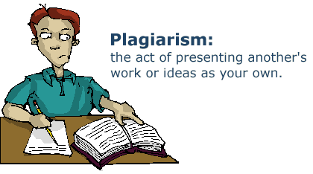
General Guidelines
Quiz
Announced
Un-announced
Assignments
All assignments will be graded
Cheating/plagiarism
Zero tolerance policy!
Partial and genuine work can get marks but plagiarized work would not be accepted at all.
There can be a penalty on plagiarism

Slide 19
Attendance Policy
Any missed class is your own responsibility
Missed quiz/assignment will follow university protocol

Slide 20
Tools We Will Use in Class
PyCharm 2021.2.2
Python 3.x
Microsoft Word

Slide 21
Class Etiquettes
Respect each others
Keep your mobiles switched off
Be careful of class timing
Late comer may be not allowed
Delay talks with colleagues
Ask questions at the end of a lecture
Avoid interruption in class

Slide 22
Open Door Policy
I would like the course to be informative and enjoyable.
Let me know what you find just, good and interesting about the course.
Let me know sooner if you feel something could be improved.

Slide 23
Why take CS3283?
Design Algorithm
As per the Church Turing Thesis: if you have any algorithm to solve a problem then you can design its machine and vice versa. Saves actual cost of implementation. Mathematical description to solve the problem.
Analyze Algorithm
Time and space complexity
Many ways to solve a single problem but what would be the efficient way?
All the problems in the world can be solved?

Slide 24
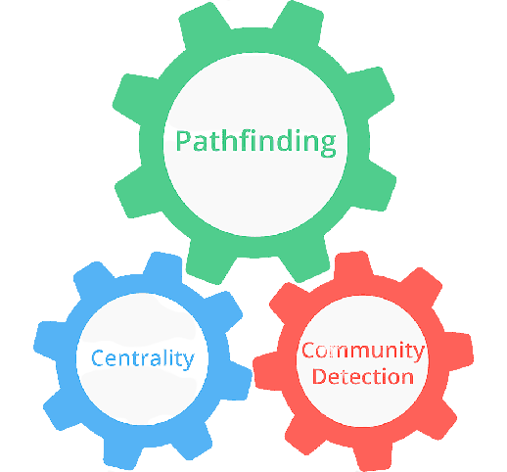
Why take CS3283?

Slide 25
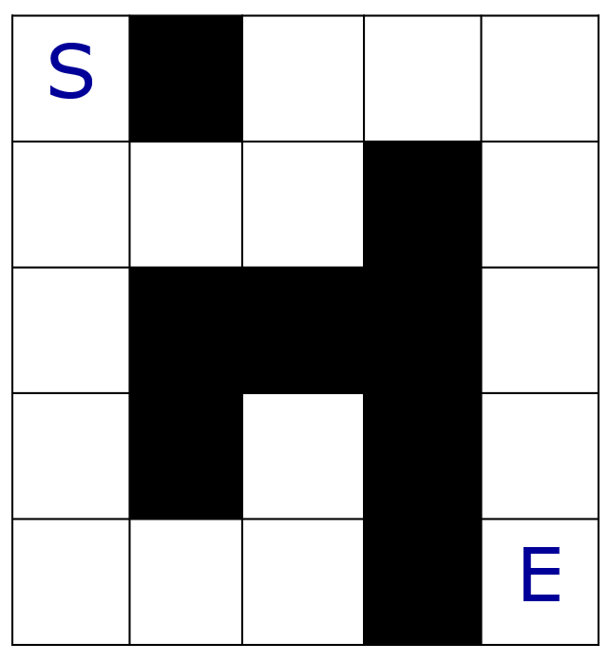
A Classical Problem
Maze
Find a path from S to E

Slide 26
Rumours
In a group of people, a rumour start from Sam to others.
Each person can spread the rumour to his/her friends.
Through how many persons will the rumour reach Emily?
Sam
John
Tim
Kate
Emily

Slide 27
Aren’t the two problems similar?
Essentially we have some vertices which are linked together by some edges.
In both problems, we want to find a path to get from one vertex to another.
In other cases, it could be some other problems.

Slide 28
WHAT ARE GRAPHS?

Slide 29
Graph
1
4
vertex
2
edge
3
In a graph, we have some vertices and edges. An edge links two vertices together, with or without a direction.
Notes:
29

Slide 30
Graph
Mathematically, a graph is defined as G=(V,E),
V is the set of vertices (singular: vertex)
E is the set of edges that connect some of the vertices
For convenience,
Label vertices with 1, 2, 3, …
Edges can be represented by their two endpoints.

Slide 31
Graph
Directed/Undirected Graph
Weighted/Unweighted Graph
Simple Graph
Connectivity

Slide 32
Graph Modelling
S
 |  |  |  | E
S
E

